Slide 1

Touch Event
START

Slide 2
Learning Goals
After the course, attendees will be able to:
Have basic understanding about gesture in android
Have basic understanding about how to use the touch API in Android applications
1/12

Slide 3
Table of contents
Input Event
Touch Event – Single touch
Touch Event – Multiple touch
1/12

Slide 4
Trainee’s missions
To complete this course and achieve goals, trainees must:
Read Lecture
Do Exercises
Take quiz
1/12

Slide 5
Input Event
Input Event
On Android, there's more than one way to intercept the events from a user's interaction with your application. When considering events within your user interface, the approach is to capture the events from the specific View object that the user interacts with. The View class provides the means to do so
Within the various View classes that you'll use to compose your layout, you may notice several public callback methods that look useful for UI events. These methods are called by the Android framework when the respective action occurs on that object

Slide 6
Input Event – Event Listener
Input Event – Event Listeners
An event listener is an interface in the View class that contains a single callback method. These methods will be called by the Android framework when the View to which the listener has been registered is triggered by user interaction with the item in the UI. Included in the event listener interfaces are the following callback methods:
onClick()
onLongClick()
onFocusChange()
From View.OnClickListener. This is called when the user either touches the item (when in touch mode), or focuses upon the item with the navigation-keys or trackball and presses the suitable "enter" key or presses down on the trackball.
From View.OnLongClickListener. This is called when the user either touches and holds the item (when in touch mode), or focuses upon the item with the navigation-keys or trackball and presses and holds the suitable "enter" key or presses and holds down on the trackball (for 1 second).
From View.OnFocusChangeListener. This is called when the user navigates onto or away from the item, using the navigation-keys or trackball.

Slide 7
Input Event – Event Listener
Input Event – Event Listeners
An event listener is an interface in the View class that contains a single callback method. These methods will be called by the Android framework when the View to which the listener has been registered is triggered by user interaction with the item in the UI. Included in the event listener interfaces are the following callback methods:
onKey()
onTouch()
onCreateContextMenu()
From View.OnKeyListener. This is called when the user is focused on the item and presses or releases a hardware key on the device
From View.OnTouchListener. This is called when the user performs an action qualified as a touch event, including a press, a release, or any movement gesture on the screen (within the bounds of the item).
From View.OnCreateContextMenuListener. This is called when a Context Menu is being built (as the result of a sustained "long click"). See the discussion on context menus in the Menus developer guide.

Slide 8
Input Event – Event Listener
How to you these call back method?
These methods are the sole inhabitants of their respective interface. To define one of these methods and handle your events, implement the nested interface in your Activity or define it as an anonymous class. Then, pass an instance of your implementation to the respective View.set...Listener() method.

Slide 9
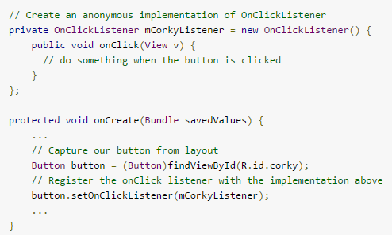
Input Event – Event Listener
Example

Slide 10
Input Event – Event Handlers
Event Handlers
If you're building a custom component from View, then you'll be able to define several callback methods used as default event handlers
Some of the common callbacks used for event handling, including:
onKeyDown(int, KeyEvent) - Called when a new key event occurs.
onKeyUp(int, KeyEvent) - Called when a key up event occurs.
onTrackballEvent(MotionEvent) - Called when a trackball motion event occurs.

Slide 11
Input Event – Event Handlers
Event Handlers
onTouchEvent(MotionEvent) - Called when a touch screen motion event occurs.
onFocusChanged(boolean, int, Rect) - Called when the view gains or loses focus.

Slide 12
Input Event – Touch Mode
Touch Mode
When a user is navigating a user interface with directional keys or a trackball, it is necessary to give focus to actionable items (like buttons) so the user can see what will accept input. If the device has touch capabilities, however, and the user begins interacting with the interface by touching it, then it is no longer necessary to highlight items, or give focus to a particular View. Thus, there is a mode for interaction named "touch mode."

Slide 13
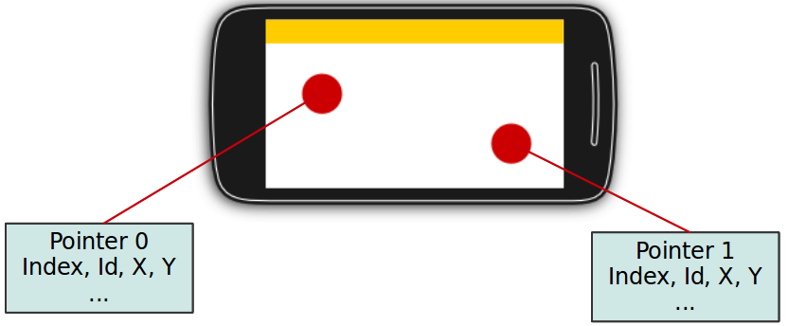
Touch Event - Android touch basics
Touch Event
The Android standard View class support touch events. You can react to touch events in your custom views and your activities. Android supports multiple pointers, e.g. fingers which are interacting with the screen.

Slide 14
Touch Event - Android touch basics
Touch Event
- The base class for touch support is the MotionEvent class which is passed to Views via the onTouchEvent() method. To react to touch events you override the onTouchEvent() method.
The MotionEvent class contains the touch related information, e.g., the number of pointers, the X/Y coordinates and size and pressure of each pointer. This method returns true if the touch event has been handled by the view. Android tries to find the deepest view which returns true to handles the touch event. If the view is part of another view (parent view), the parent can claim the event by returning true from the onInterceptTouchEvent() method. This would send an MotionEvent.ACTION_CANCEL event to the view which received previously the touch events.
- To react to touch events in an activity, register an OnTouchListener for the relevant Views.

Slide 15
Touch Event – Single Touch
Single touch
- If single input is used you can use the getX() and getY() methods to get the current position of the first finger.
Via the getAction() method you receive the action which was performed. The MotionEvent class provides the following constants to determine the action which was performed

Slide 16
Touch Event – Single Touch
Single touch
Event | Description
MotionEvent.ACTION_DOWN | New touch started
MotionEvent.ACTION_MOVE | Finger is moving
MotionEvent.ACTION_UP | Finger went up
MotionEvent.ACTION_CANCEL | Current event has been canceled, something else took control of the touch event
MotionEvent.ACTION_POINTER_DOWN | Pointer down (multi-touch)
MotionEvent.ACTION_POINTER_UP | Pointer up (multi-touch)

Slide 17
Touch Event – Multi touch
Multi touch
- Multi-touch is available since Android 2.0 and has been improved in the version 2.2. This description uses the API as of version 2.2.
The MotionEvent.ACTION_POINTER_DOWN and MotionEvent.ACTION_POINTER_UP are send starting with the second finger. For the first finger MotionEvent.ACTION_DOWN and MotionEvent.ACTION_UP are used.
- The getPointerCount() method on MotionEvent allows you to determine the number of pointers on the device. All events and the position of the pointers are included in the instance of MotionEvent which you receive in the onTouch() method

Slide 18
Touch Event – Multi touch
Multi touch
- To track the touch events from multiple pointers you have to use the MotionEvent.getActionIndex() and theMotionEvent.getActionMasked() methods to identify the index of the pointer and the touch event which happened for this pointer
This pointer index can change over time, e.g. if one finger is lifted from the device. The stable version of a pointer is the pointer id, which can be determined with the getPointerId(pointerIndex) method from the MotionEvent object

Slide 19
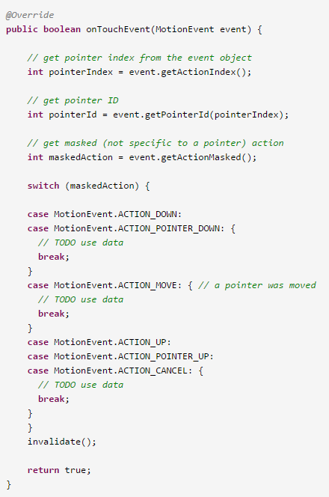

Slide 20
Demo and Exercise!

Slide 21
Gesture
Gesture
- Touch screens are a great way to interact with applications on mobile devices. With a touch screen, users can easily tap, drag, fling, or slide to quickly perform actions in their favorite applications.
- For app developers. the Android framework makes it's easy to recognize simple actions, like a swipe, but it has been more difficult to handle complicated gestures, sometimes requiring developers to write a lot of code

Slide 22
Gesture
Gesture
- Built-in gesture detectors provided in the Android SDK to detect common user motions in a consistent fashion: Gesture Builder and GestureOverlayView
- Android currently has two different classes that can detect navigational gestures:
+ The GestureDetector class can be used to detect common single-touch gestures.
+ The ScaleGestureDetector can be used to detect multi-touch scale gestures

Slide 23
Demo and Exercise!

Slide 24
Exit Course
THANK YOU

